Slide 1
Measuring your Trajectory
Adrian Cockcroft
AWS VP Cloud Architecture Strategy
@adrianco

Slide 2
OLD WORLD IT
Marketing analytics
Employees at work
Sales channels
Factories + supply chain

Slide 3
NEW WORLD IT
OLD WORLD IT
Marketing analytics
Employees at work
Sales channels
Factories + supply chain

Slide 4
Mobile employees
NEW WORLD IT
Employees at work
Online marketing
Social media
Continuous supply tracking
Factories + supply chain
Online sales + delivery
Just in time production
IoT connected things

Slide 5
Personalization
Customer analytics
New channels direct to customer
More things, more scale, rapid change
New Needs
Notes:
Education example
New World: Product is interactive online content, customer is end user. Result is a personal learning plan. Engagement and retention
New Needs: Personalization, customer tracking, new channels direct to consumer by passing existing institutions

Slide 6
AWS: Unblocking Innovation for Digital Transformation with Enterprise Customers

Slide 7
Blockers for Innovation
Culture
Skills
Organization
Finance
Leadership Systems and Feedback
Training and Compensation
Silos Project to Product
Capex
Versus Opex

Slide 8
Blockers for Innovation
Culture
Leadership Systems and Feedback
Centralized slow decision making
Lack of trust
Inflexible policies and processes
Skills
Organization
Finance
Training and Compensation
Silos Project to Product
Capex
Versus Opex

Slide 9
Blockers for Innovation
Culture
Leadership Systems and Feedback
Stephen Orban
Ahead in the Cloud
Mark Schwartz
A Seat at the Table
(coming soon, War and Peace and IT)
Skills
Organization
Finance
Training and Compensation
Silos Project to Product
Capex
Versus Opex

Slide 10
Culture
If you want to build a ship, don’t drum up the people to gather wood, divide the work, and give orders. Instead, teach them to yearn for the vast and endless sea.
Antoine de Saint-Exupéry, author of “Le Petit Prince” (“The Little Prince”)

Slide 11
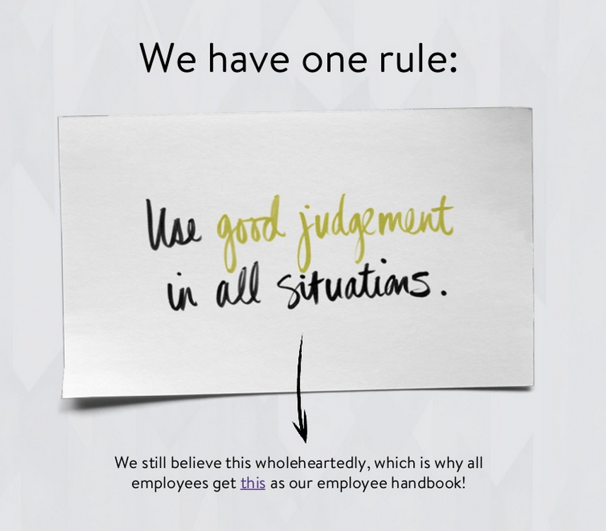
Culture
Nordstrom Technology NorDNA Culture Deck

Slide 12
Values are what we value
High performance
Freedom & responsibility
Context, not control
Highly aligned, loosely coupled
Pay top of market
Promotions & development
Culture
Seven Aspects of Netflix Culture

Slide 13
Customer obsession
Ownership
Invent and simplify
Are right, a lot
Hire and develop the best
Insist on the highest standards
Think big
Bias for action
Frugality
Learn and be curious
Earn trust of others
Dive deep
Have backbone; disagree and commit
Deliver results
Culture
Amazon leadership principles

Slide 14
Intentional
Appropriate
Judgement
Culture

Slide 15
Blockers for Innovation
Culture
Skills
Organization
Finance
Leadership Systems and Feedback
Training and Compensation
Silos Project to Product
Capex
Versus Opex
Centralized decision making
Lack of trust
Inflexible policies and processes

Slide 16
Blockers for Innovation
Skills
Training and Compensation
Train existing staff on cloud tech
Fund pathfinder teams
Be prepared to pay more to keep the best people after training!
Culture
Organization
Finance
Leadership Systems and Feedback
Silos Project to Product
Capex
Versus Opex

Slide 17
Blockers for Innovation
Skills
Training and Compensation
Get out of the way of innovation
Read the new book “Powerful”
by Patty McCord
Netflix Chief Talent Officer
Culture
Organization
Finance
Leadership Systems and Feedback
Silos Project to Product
Capex
Versus Opex

Slide 18
Blockers for Innovation
Culture
Skills
Organization
Finance
Leadership Systems and Feedback
Training and Compensation
Silos Project to Product
Capex
Versus Opex
Train existing staff on cloud tech
Fund pathfinder teams
Be prepared to pay more to keep the best people after training!

Slide 19
Blockers for Innovation
Organization
Move from Projects to Product Teams
Long term product ownership
Continuous delivery
DevOps and “run what you wrote”
Reduce tech-debt and lock-in
Culture
Skills
Finance
Leadership Systems and Feedback
Training and Compensation
Capex
Versus Opex
Silos Project to Product

Slide 20
Blockers for Innovation
Organization
Move from Projects to Product Teams
Project to Product
by Mik Kersten
The DevOps
Handbook
by Gene Kim et. al.
Culture
Skills
Finance
Leadership Systems and Feedback
Training and Compensation
CapEx
Versus OpEx
Silos Project to Product

Slide 21
Blockers for Innovation
Culture
Skills
Organization
Finance
Leadership Systems and Feedback
Training and Compensation
Silos Project to Product
Capex
Versus Opex

Slide 22
Blockers for Innovation
Finance
Capex Versus Opex
Is your CTO defining your technology architecture or is the CFO really in charge?
Culture
Skills
Organization
Leadership Systems and Feedback
Training and Compensation
Silos Project to Product

Slide 23
Blockers for Innovation
Finance
Capex Versus Opex
Datacenter to Cloud
Waterfall to Agile and DevOps
Understand the impact on EBITDA
Plan ahead, don’t surprise the CFO or your shareholders
Culture
Skills
Organization
Leadership Systems and Feedback
Training and Compensation
Silos Project to Product

Slide 24
Pathway for Digital Transformation
Speed
Scale
Strategic
!
Time to Value
Distributed Optimized Capacity
Critical Workloads Datacenter Replacement

Slide 25
What are the fundamental metrics for innovation?

Slide 26
You don’t add innovation to an organization
You get out of its way!

Slide 27
Time to Value
TICKET
How long?
Do some work
Value to a customer

Slide 28
Time to Value
TICKET
Months?
Do some work
Value to a customer

Slide 29
Time to Value
TICKET
Days?
Do some work
Value to a customer

Slide 30
Time to Value
TICKET
Minutes?
Do some work
Value to a customer

Slide 31
There is no economy of scale in software
Smaller changes are better

Slide 32
Lots of small changes
Automated continuous delivery pipeline
Tagging, feature flags, A/B tests
Rapid cheap builds

Slide 33
Lots of small changes
HOURS
to
SECONDS
Move from Java Monolith to Go Microservices
SLOW build
BIG build
FAST build
SMALL build

Slide 34
Easier to
tell if it breaks
Change one small thing at a time
roll back to previous version
Easier to
measure time to value
Easier to

Slide 35
De-couple
New code from new feature
Incrementally change system with many small safe updates
Turn on features for testing and when it works – for everyone

Slide 36
Less risk
Faster problem detection
Faster repair
Less work in progress
Less time merging changes
Happier developers
Faster flow
Small changes

Slide 37
How do we get there?
Measure time to value everywhere
Automate collection and reporting of commit to deploy

Slide 38
How do we get there?
Learn to do small things quickly
Don’t get bogged down speeding up everything

Slide 39
How do we get there?
Measure cost per deploy
Build and test cost in $ and people → drive to reduce
Number of tickets filed per deploy → drive to one
Number of meetings per deploy → drive to zero

Slide 40
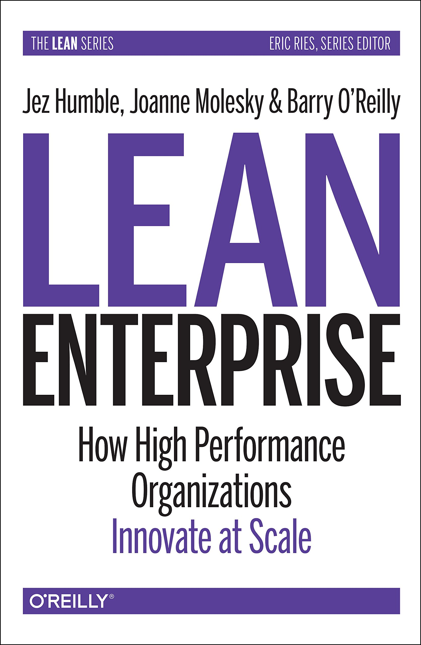
Hypothesis-driven development

Slide 41
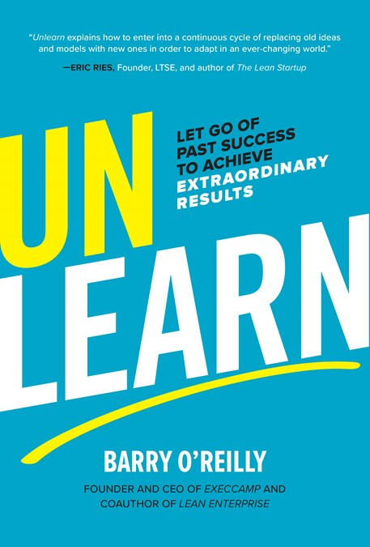
Break away from your old ways of working

Slide 42
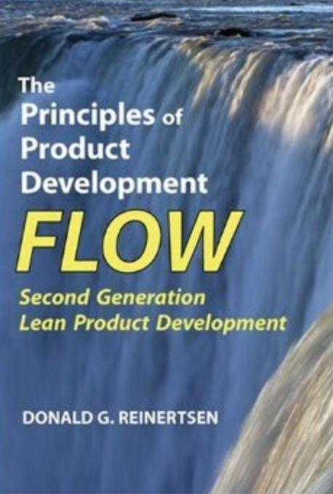
Theoretical basis for using consistently small changes

Slide 43
Get rid of 90% of your project managers as you move to continuous improvement

Slide 44
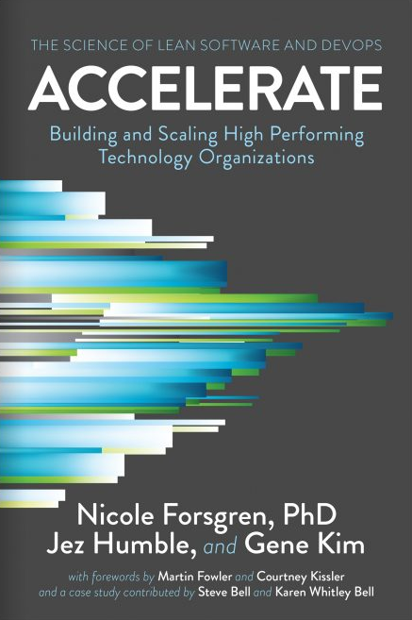
Survey data showing that low latency time-to-value works

Slide 45
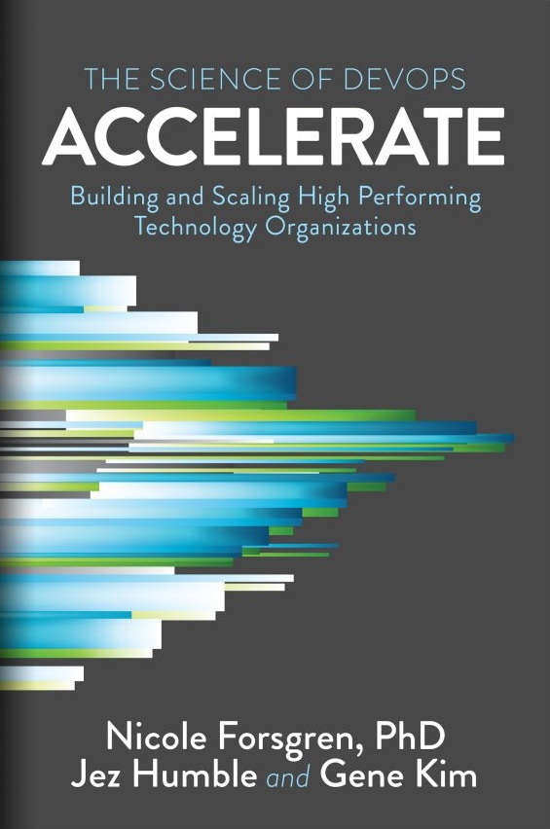
Pathway for Digital Transformation
Speed
Scale
Strategic
Time to Value
The fast companies are
440x
faster than the slow
We found that, compared to low performers, high performers have:
46 times more frequent code deployments
440 times faster lead time from commit to deploy
170 times faster mean time to recover from downtime
5.0 times lower change failure rate (1/5 as likely for a change to fail)
!
Months
Hours
Distributed Optimized Capacity
Critical Workloads Datacenter Replacement
https://itrevolution.com/book/accelerate/

Slide 46
Time to Value (2018 DORA Report)
The elite companies are
2,555x
faster than the slow
We found that, compared to low performers, high performers have:
46 times more frequent code deployments
2,555 times faster lead time from commit to deploy
2,604 times faster mean time to recover from downtime
7 times lower change failure rate (1/7 as likely for a change to fail)
The elite are moving further ahead –
months to minutes…
https://itrevolution.com/book/accelerate/

Slide 47
Time to Value
Learn to do simple things quickly to unblock innovation
Avoid complex one-size-fits-all processes

Slide 48
Pathway for Digital Transformation
Speed
Scale
Strategic
Time to Value
The best IT architecture today is:
Minimalist, messy and inconsistent
Provides guard rails for security, scalability and availability
Designed to evolve rapidly and explore new technologies
Supports low latency continuous delivery
!
Distributed Optimized Capacity
Critical Workloads Datacenter Replacement

Slide 49
Pathway for Digital Transformation
Speed
Scale
Strategic
!
Time to Value
Distributed Optimized Capacity
Critical Workloads Datacenter Replacement

Slide 50
Pathway for Digital Transformation
Speed
Scale
Strategic
Distributed Optimized Capacity
Highly Scaled
Distributed for Availability
Cost Optimized High Utilization
Cloud Native Architecture
Time to Value

Slide 51
Cloud Native Principles
Pay as you go, afterwards
Self service—no waiting
Globally distributed by default
Cross-zone/region availability models
High utilization—turn idle resources off
Immutable code deployments

Slide 52
Containers or Serverless?
Or both?

Slide 53
What is the User Need?

Slide 54
What is the Problem You Are Trying to Solve?
Make a model spaceship quickly and cheaply

Slide 55
Traditional
Development
Design a prototype
Carve from modelling clay

Slide 56
Traditional
Development
Carve from modelling clay
Design a prototype
Make molds

Slide 57
Traditional
Development
Make molds
Carve from modelling clay
Produce injection molded parts

Slide 58
Traditional
Development
Produce injection molded parts
Make molds
Assemble parts

Slide 59
Traditional
Development
Assemble parts
Sell finished toy
Produce injection molded parts

Slide 60
Traditional
Development
Design a prototype
Carve from modelling clay
Make molds
Produce injection molded parts
Assemble parts
Sell finished toy
Assemble parts

Slide 61
Traditional
Development
Design a prototype
Carve from modelling clay
Make molds
Produce injection molded parts
Assemble parts
Sell finished toy

Slide 62
Traditional
Development
Rapid
Big bag of blocks
Instructions
A few hours

Slide 63
Rapid
Development
Big bag of blocks
Instructions
A few hours
A finished toy

Slide 64
Rapid
Development
Lacks fine detail
Recognizable, but not exactly what was asked for
A few hours
Big bag of blocks
Instructions
Easy to modify and extend
A finished toy

Slide 65
Optimization
Take a group of Lego bricks…
…and form a new custom brick
A few hours
A more specialized common component
Big bag of blocks
Instructions
A finished toy

Slide 66
Traditional
Rapid Development
Full custom design
Months of work
Custom components may be fragile and need to be debugged and integrated
Too many detailed choices
Long decision cycles
Building bricks assembly
Hours of work
Standard reliable components scale and are well understood and interoperable
Need to adjust requirements to fit the patterns available
Constraints tend to reduce debate and speed up decisions

Slide 67
Containers
Serverless
Custom code and services
Lots of choices of frameworks and API mechanisms
Where needed, optimize serverless applications by also building services using containers to solve for
Lower startup latency
Long running compute jobs
Predictable high traffic
Serverless events and functions
Standardized choices
Combine these building blocks
AWS Lambda
API Gateway
Amazon SNS, SQS
Amazon DynamoDB
AWS Step Functions

Slide 68
Pathway for Digital Transformation
Speed
Scale
Strategic
!
Time to Value
Distributed Optimized Capacity
Critical Workloads Datacenter Replacement

Slide 69
Datacenter to cloud migrations are under-way for the most business and safety critical workloads
AWS and our partners are developing patterns, solutions and services for customers in all industries including travel, finance, healthcare, manufacturing…

Slide 70
Do you have a backup datacenter?
How often do you failover apps to it?
How often do you failover the whole datacenter at once?
“Availability Theater”

Slide 71
A fairy tale…
Once upon a time, in theory, if everything works perfectly, we have a plan to survive the disasters we thought of in advance.
How did that work out?

Slide 72
Forgot to renew domain name…
SaaS vendor
Entertainment site
Didn’t update security certificate and it expired…
Datacenter flooded in hurricane Sandy…
Finance company, Jersey City
Whoops!
YOU, tomorrow

Slide 73
“You can’t legislate against failure, focus on fast detection and response.”
—Chris Pinkham

Slide 74
The Network Is Reliable ACM Queue 2014
Bailis & Kingsbury
@pbailis @aphyr
(Spoiler—it isn’t…)

Slide 75
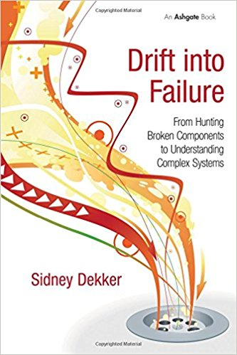
Drift Into Failure
Sydney Dekker
Everyone can do everything right at every step, and you may still get a catastrophic failure as a result…

Slide 76
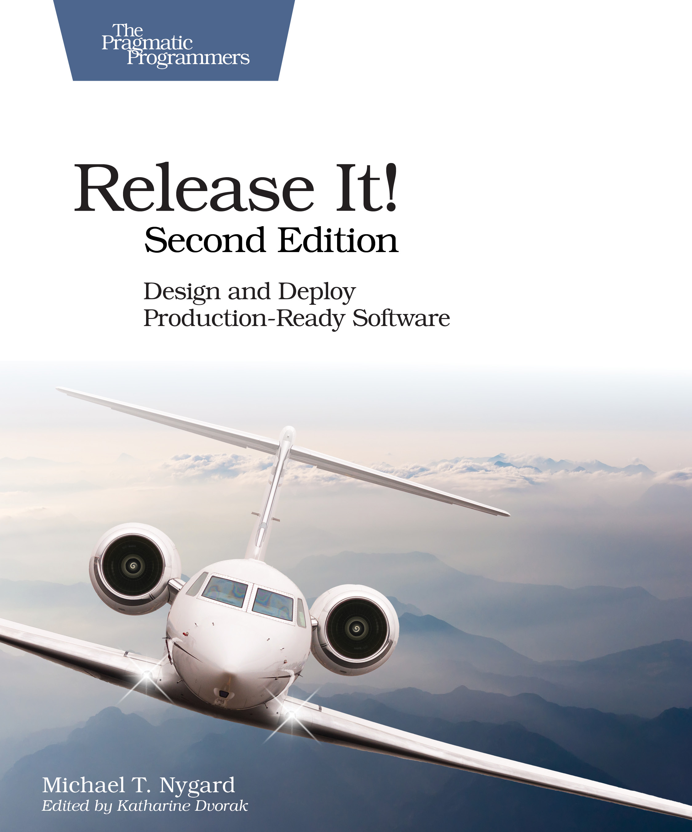
Release It! Second Edition 2017
Michael Nygard
Bulkheads, circuit breakers, and some new ideas…

Slide 77
Resilience
Past
Present
Future
?
Disaster recovery
Chaos engineering
Resilient
critical systems

Slide 78
Resilience
2004
2010
2012
2016
2017
2018
2004
Amazon—Jesse Robbins. Master of disaster
2010
Netflix—Greg Orzell. @chaosimia—First implementation of Chaos Monkey to enforce use of auto-scaled stateless services
2012
NetflixOSS open sources simian army
2016
Gremlin Inc founded
Chaos engineering
2017
Netflix chaos eng book. Chaos toolkit open source project
2018
Chaos concepts getting adoption, more startups

Slide 79
Chaos architecture
Four layers
Two teams
An attitude

Slide 80
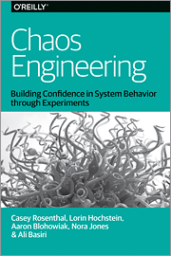
People
Application
Chaos Engineering Team
Switching
Infrastructure

Slide 81
Chaos
architecture
People
Application
Four layers
Two teams
An attitude— Find the weakest link
Tools
Tools
Chaos Engineering Team
Switching
Security Red Team
Infrastructure

Slide 82
You can only be as strong as your weakest link
Dedicated teams are needed to find weaknesses before they take you out!

Slide 83
Failures are a system problem— lack of safety margin
Not something with a root cause of component or human error

Slide 84
Experienced staff
Robust applications
Dependable switching fabric
Redundant service foundation

Slide 85
Cloud provides the automation that leads to chaos engineering

Slide 86
As datacenters migrate to cloud, fragile and manual disaster recovery processes can be standardized and automated

Slide 87
Testing failure mitigation will move from a scary annual experience to automated continuously tested resilience
Time to Value
Distributed Optimized Capacity

Slide 88
Thank you and questions?
Speed
Scale
Strategic
!
Time to Value
Distributed Optimized Capacity
Critical Workloads Datacenter Replacement

